Slide 1




Steklov Spectral Geometry for Extrinsic Shape Analysis
Yu Wang
Mirela Ben-Chen
Iosif Polterovich
Justin Solomon

Slide 2
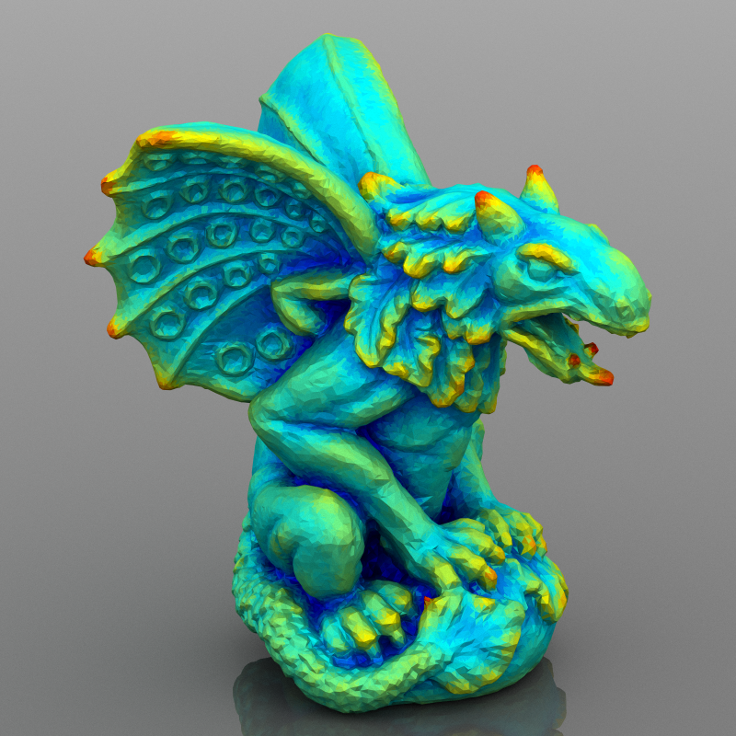
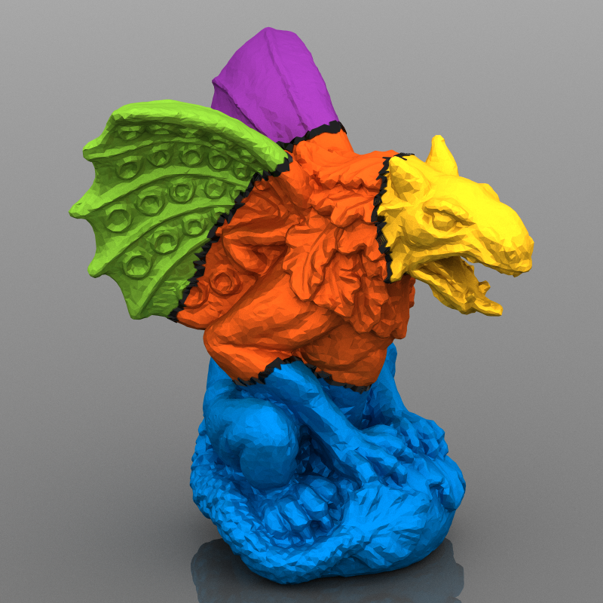
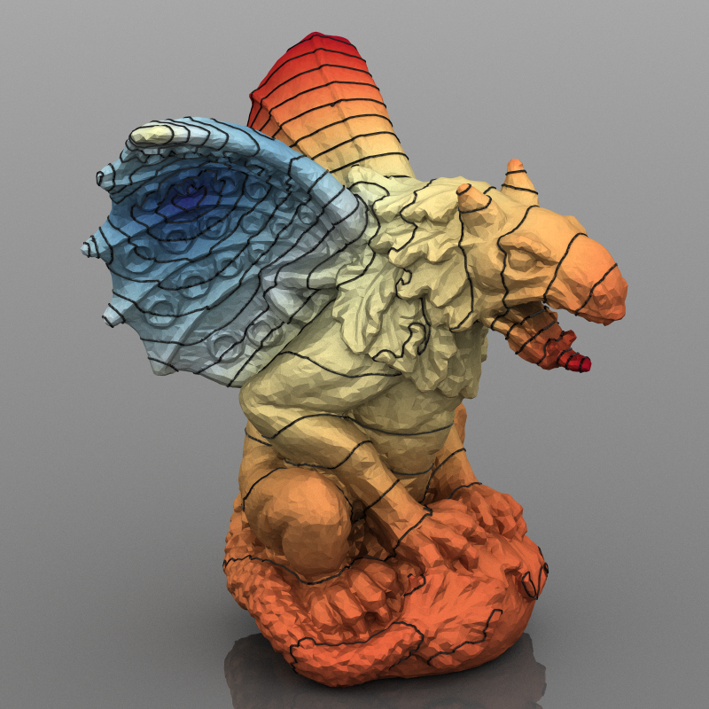

Steklov Spectral Geometry for Extrinsic Shape Analysis
Yu Wang Mirela Ben-Chen Iosif Polterovich Justin Solomon
ACM Transactions on Graphics 38(1)
SIGGRAPH 2019
arXiv:1707.07070
Notes:
Thanks XXX for the introduction. Today I am happy to talk about our work on applying the Steklov spectral geometry for the task of extrinsic shape analysis.

Slide 3
Outline: Steklov Spectral Geometry for Extrinsic Shape Analysis
Background in extrinsic and intrinsic geometry.
Our solution: an extrinsic geometric operator.
Theoretical properties and empirical behaviors of our operator.
A brief look at the implementation details.
Notes:
Here is the outline for today’s presentation.
First I will introduce some background knowledge, particularly the basic notion of extrinsic and intrinsic geometry which will define our problem of extrinsic shape analysis.
Then I will talk about our solution, a particular geometric operator we propose to use.
Next, I will talk about some theoretical properties and empirical behaviors of our operator.
Finally, we will briefly look into details of the implementation.
------------------------------------------------------
Let us first go trough a few basic concepts
that will be used throughout the presentation,
With these basic notions of geometry,
Now we can talk about our problem of extrinsic shape analysis.
A boundary element method with various acceleration techniques.

Slide 4
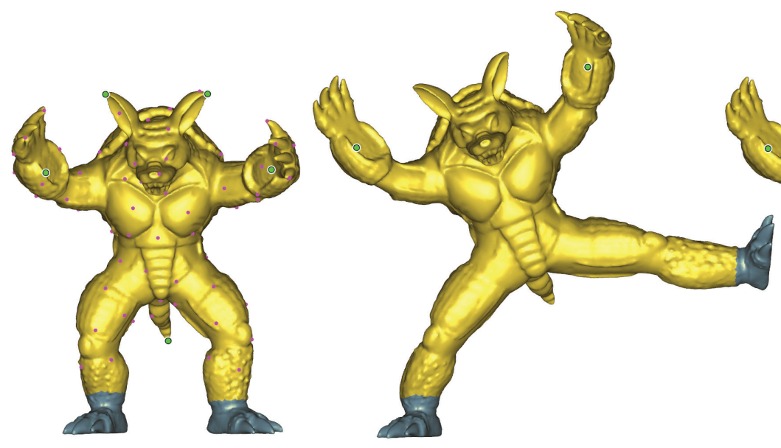
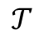
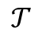
Extrinsic Geometry vs. Intrinsic Geometry
Extrinsic geometry cares about spatial embedding of the shape.
Intrinsic geometry studies properties that can be measured without leaving the surface, e.g. geodesic distances.
$$𝒯$$
$$𝒯$$
Euclidean
Notes:
Geometry, simply speaking, cares about how to measure the distance between two points.
Given these two points on the surface, the so-called extrinsic geometry
[1] simply considers the Euclidean distance between them; it corresponds to this orange line directly connection them.
We can see, under some transformation T, the Euclidean distance changes significantly.
Say, between the feet of armadillo.
------------------------------------
%
The intrinsic approach, restricts its consideration to quantities that can be measured without leaving the surface.
While the extrinsic approach, simply treats a surface as a set points living in 3D.
-----------------------------------------------------------------------
TODO: draw geodesics.

Slide 5
Extrinsic Geometry vs. Intrinsic Geometry
Extrinsic geometry cares about spatial embedding of the shape.
Intrinsic geometry studies properties that can be measured without leaving the surface, e.g. geodesic distances.
$$𝒯$$
$$𝒯$$
Geodesic
Notes:
on the other hand,
The intrinsic approach, restricts its consideration to quantities that can be measured without leaving the surface. This leads to a more stable metric.
Intrinsic geometry,
[1] considers the shortest path on the surface, the geodesic, between the two points. The geodesic corresponds to this curve in green and it remains unchanged under transformation T.
-----------------------------------------

Slide 6

Review: Motivations in Intrinsic Shape Analysis
Intrinsic approaches are invariant to isometry (“pose invariant”).
Real-world objects are usually subject to (near-) isometries.
Isometry $𝒯$: length-preserving map
$$𝒯$$
$$𝒯$$
Notes:
Here, the transformation T is known as isometry, since it preserves the length of any curve on the surface, without distortion.
[1] Intrinsic methods are desirable due to invariance to isometry by design, and
[2] we know real-world objects are usually transformed by (near-) isometries.
Consequently, the intrinsic method does not distinguish objects under usual transformations.
This is desirable, say, in shape classifications: any intrinsic method will consider the two armadillo in different poses exactly same by design.
--------------------------------------------------
The intrinsic approach is popular in shape analysis for the following reason.
between two sheets, and the one between two armadillos are both examples of isometries.
Recall isometries are transformations that preserve the length of any curve on the surface, and isometries do not introduce any distortion
Invariant to translation and rotation
in addition to being invariant to translation and rotation,
The intrinsic geometry was introduced by the Germany mathematician Gauss two hundred years ago,
and since then it has been part of the central object to study in modern mathematics.
The intrinsic perspective has also been adopted since the early days of graphics and shape analysis for the following reasons.
First, intrinsic method, by design is invariant to translations and rotation.
Second, intrinsic method is invariant to isometry, that is a transformation not introducing any distortion.
Consequently, the intrinsic method does not distinguish objects subject to isometric maps.
This is desired, say, for shape classifications.
-------------------------------------------------
Almost invariant to near-isometry (e.g. deformation)

Slide 7
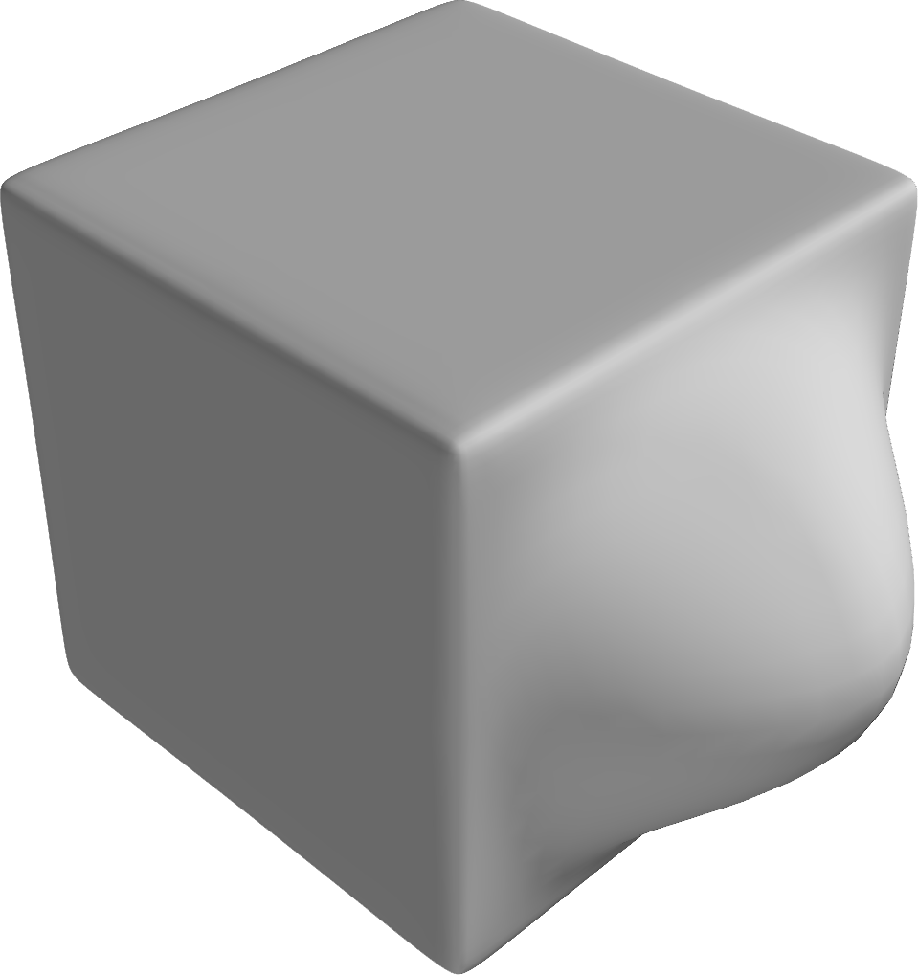
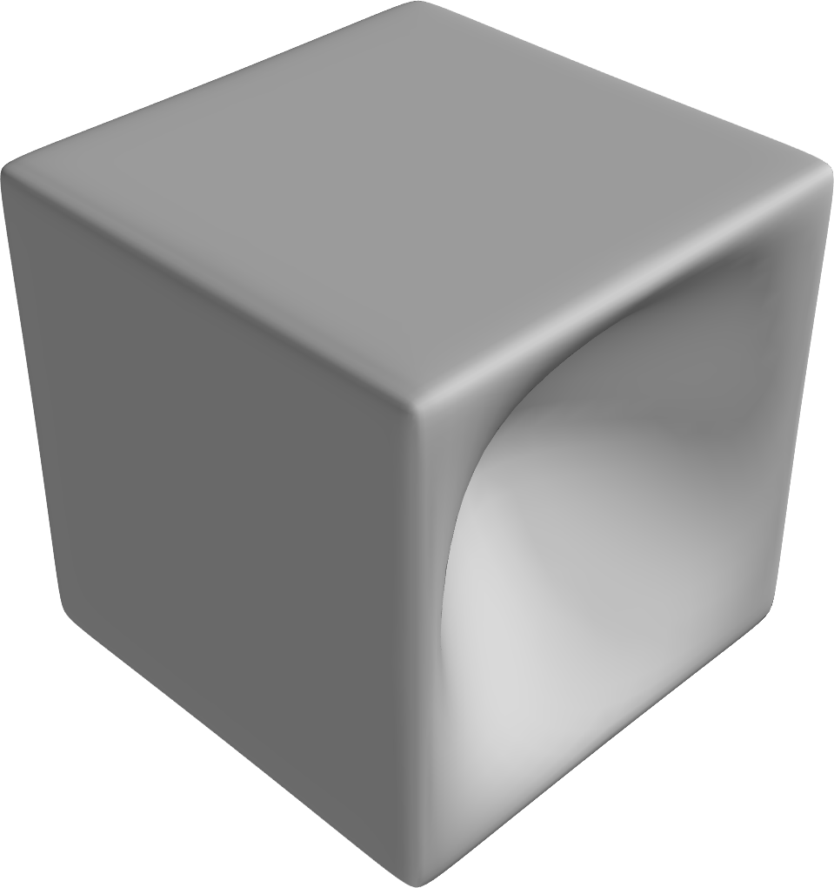
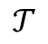
Notion of Intrinsic Geometry can be Counterintuitive
$$𝒯$$
Notes:
However, despite the advantage, the intrinsic approach can lead to undesirable consequences.
Here I am showing you two isometric cubes with either an outward or inward bump.
While most people probably will agree that two cubes are different, the intrinsic method, by design, cannot distinguish them at all.
So we see
this notion of intrinsic geometry can be counterintuitive.
Especially to users and practioners without much knowledge in geometry.
------------------------------------------------------

Slide 8
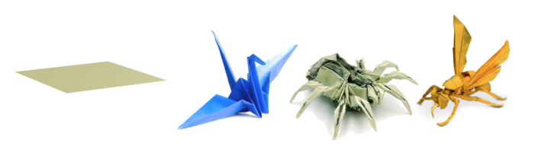
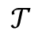
Intrinsic Information is Incomplete
$$𝒯$$
Intrinsic geometry: any origami equivalent to a piece of flat paper!
Origami images from http://image.google.com/
Notes:
Here is another extreme example.
We have this nice collection of origami, all of which are made from a piece of flat paper in the left.
All these shapes have exactly same intrinsic structure as the flat paper, and all useful information are extrinsic.
As a result, any intrinsic method will fail to give meaningful results.
In summary,
Intrinsic information itself is an incomplete description of geometry.
We need extrinsic information.
-------------------------------------------------------------------------------
Hopefully I have convinced you that extrinsic geometry are critical.
Indeed, here all information of interests are extrinsic and any intrinsic method will fail to give meaningful results..
Intrinsic information itself is an incomplete description of geometry.
The origami is another example that extrinsic geometry can be critical.
Intrinsic geometry information is incomplete.

Slide 9
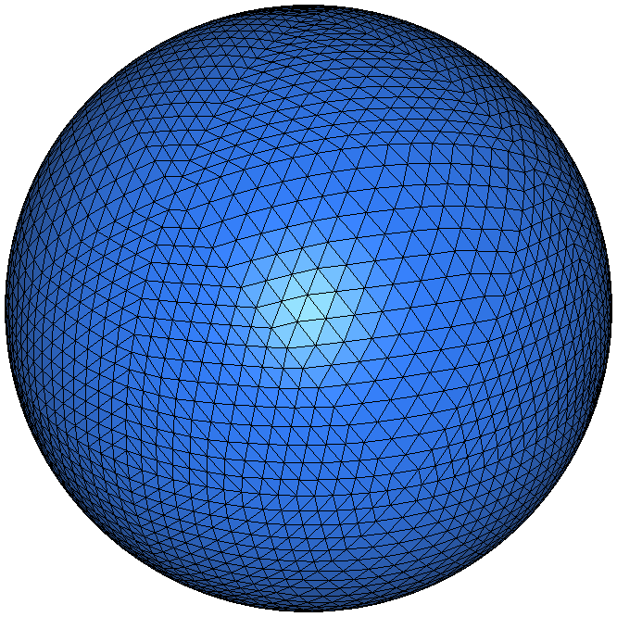
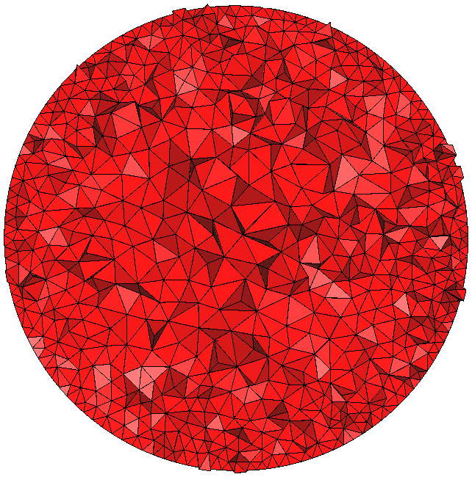
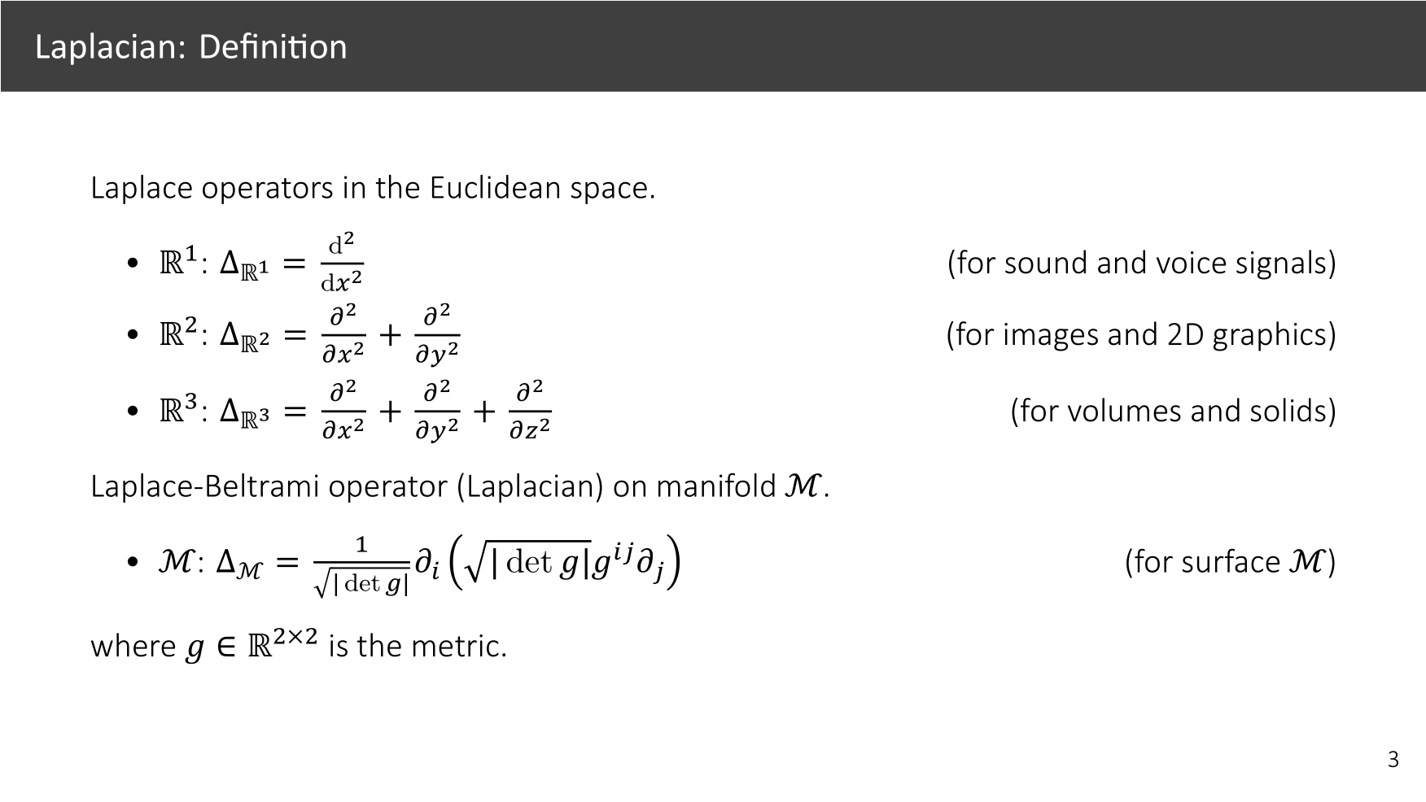
Existing Work in Extrinsic Geometry
Extrinsic histogram:
SHOT [Tombari et al. 2010]
D2 descriptors [Osada et al. 2002]
Offset surface: [Corman et al. 2017]
Volume–based:
[Raviv et al. 2010]
[Litman et al. 2012]
[Wang and Wang 2015]
[Patane 2015]
[Rustamov 2011]
“Volumetrization” is hard: clean input mesh
Inability to handle open surfaces/triangle soups
Inconsistency unless super dense volume mesh
Cannot attribute shape difference onto surface
Notes:
There are many existing methods that could capture various aspects of extrinsic geometry.
[1] The one most relevant to ours the volume-based method, in which the given input surface will be converted to a volumetric mesh first, and all subsequent computations are conducted on the volumetric domain.
However, Generating volumetric mesh itself is challenging, and requires a clean, closed and watertight mesh to start with.
The results can be inconsistent, dependent on this volume mesh.
And we still have to attribute interior shape difference onto the surface.
-----------------------------
, without much more additional variables.
These algorithms, are designed for specific tasks.
Hopefully, I have convinced you that extrinsic geometry are important.
Extrinsic algorithms for each specific task

Slide 10
Our Problem: Extrinsic Geometry Analysis from a Boundary Representation
Origami images from http://image.google.com/
Notes:
So instead we are interested in a method using a boundary representation directly working with surfaces only,
that can capture this additional extrinsic structure,
----------------------------------------------------------------------------
Traditional methods in shape analysis are intrinsic

Slide 11
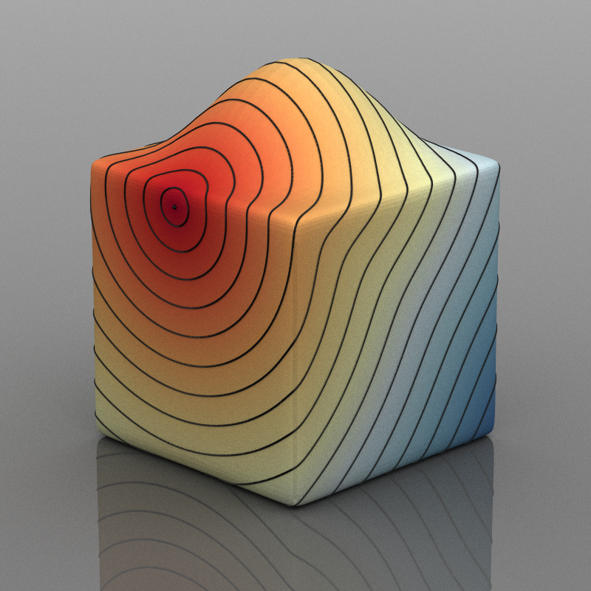
Review: (Intrinsic) Shape Analysis
Distance [Lipman et al. 2010; Crane et al. 2013]
Segmentation [Reuter et al. 2009]
Shape description [Sun et al. 2009]
Shape retrieval [Bronstein et al. 2011]
Correspondence [Ovsjanikov et al. 2012]
Shape exploration [Rustamov et al. 2013]
Vector field processing [Azencot et al. 2013]
Simulation [Azencot et al. 2014]
Deformation [Boscaini et al. 2015]
Notes:
let’s take a step back and have another look at intrinsic shape analysis,
there are many tasks of interest, including distance computation,
---------------------------------------
Also we are going to take an operator approach.
To explain this,
Intrinsic shape analysis cares about many tasks including distance computation,

Slide 12
Review: (Intrinsic) Shape Analysis
Distance [Lipman et al. 2010; Crane et al. 2013]
Segmentation [Reuter et al. 2009]
Shape description [Sun et al. 2009]
Shape retrieval [Bronstein et al. 2011]
Correspondence [Ovsjanikov et al. 2012]
Shape exploration [Rustamov et al. 2013]
Vector field processing [Azencot et al. 2013]
Simulation [Azencot et al. 2014]
Deformation [Boscaini et al. 2015]
Notes:
shape segmentation,

Slide 13
Review: (Intrinsic) Shape Analysis
Distance [Lipman et al. 2010; Crane et al. 2013]
Segmentation [Reuter et al. 2009]
Shape description [Sun et al. 2009]
Shape retrieval [Bronstein et al. 2011]
Correspondence [Ovsjanikov et al. 2012]
Shape exploration [Rustamov et al. 2013]
Vector field processing [Azencot et al. 2013]
Simulation [Azencot et al. 2014]
Deformation [Boscaini et al. 2015]
Notes:
local geometry descriptor, and so on.
---------------------------------

Slide 14
Review: (Intrinsic) Shape Analysis
def Intrinsic_Shape_Analysis( mesh)
L = Laplacian_Operator( mesh)
delete mesh
results = compute( L)
……
……
return results
Distance [Lipman et al. 2010; Crane et al. 2013]
Segmentation [Reuter et al. 2009]
Shape description [Sun et al. 2009]
Shape retrieval [Bronstein et al. 2011]
Correspondence [Ovsjanikov et al. 2012]
Shape exploration [Rustamov et al. 2013]
Vector field processing [Azencot et al. 2013]
Simulation [Azencot et al. 2014]
Deformation [Boscaini et al. 2015]
Notes:
Here, I have this long list of tasks
\\that including many higher-level tasks built upon basic ones.
\\This is just a small sampling of very large literatures.
[1] Surprisingly, all these methods can be summarized by a common algorithm template.
[2] Somewhere in the code of these methods, the Laplacian will be constructed, and then all the remaining computation are based on the Laplacian instead.
High level tasks based on the lower level ones.
Correspondence.
-----------------------------
all these methods share a common algorithmic template
or related operator

Slide 15
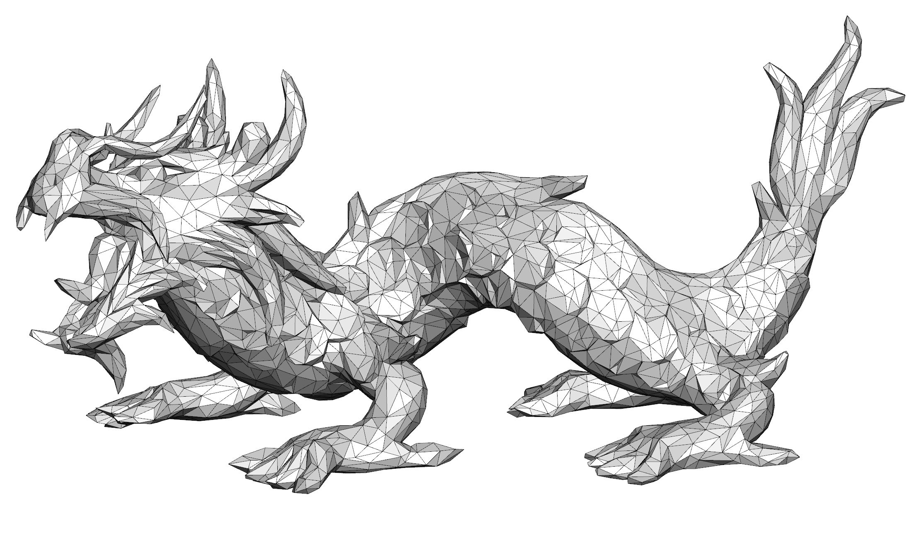
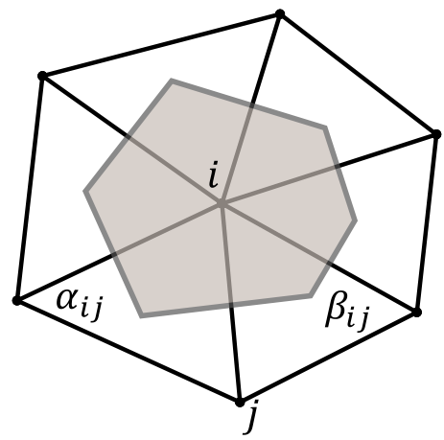
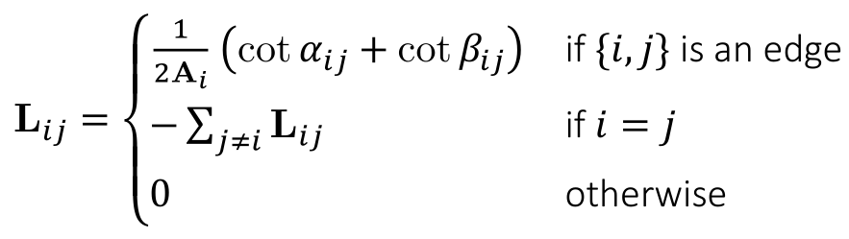
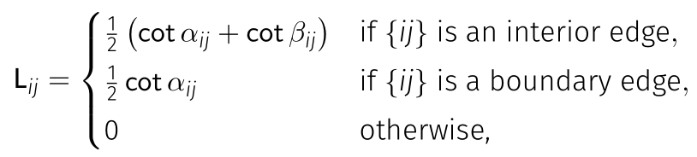


Laplacian Operator/Matrix Capturing Intrinsic Geometry
$$L∈ℝ^{n×n}$$
The Laplacian operator (i.e. matrix) encodes the surface up to isometry.
$n$: #vertices.
n is the number of mesh vertices.
Notes:
Recall
The Laplacian, in the discrete form, is just an n by n matrix on a mesh with n vertices.
[1] Laplacian is assembled using local geometry according to this cotangent formula, that we have seen many times.
The Laplacian encodes intrinsic geometry information up to isometry.
It enjoys a long list of nice mathematical properties
The Laplacian operator appears in almost every task in intrinsic shape analysis.
Graph Laplacian, whose entries determined by the local geometry.
-----------------------------------------
Laplacian is mathematically well understood.
, contributing to its popularity.
Where n is the number of vertices in the mesh.

Slide 16
Generalization from planar domain to a curved domain
Laplacian
Notes:
Explain the Laplacian on a curved surface.
Using the metric tensor g associated with each point on the surface
Connect to the cotangent formula.
The Laplacian operator is defined for continuous surfaces.
The cotangent Laplacian is a discretization of the continuous one.

Slide 17
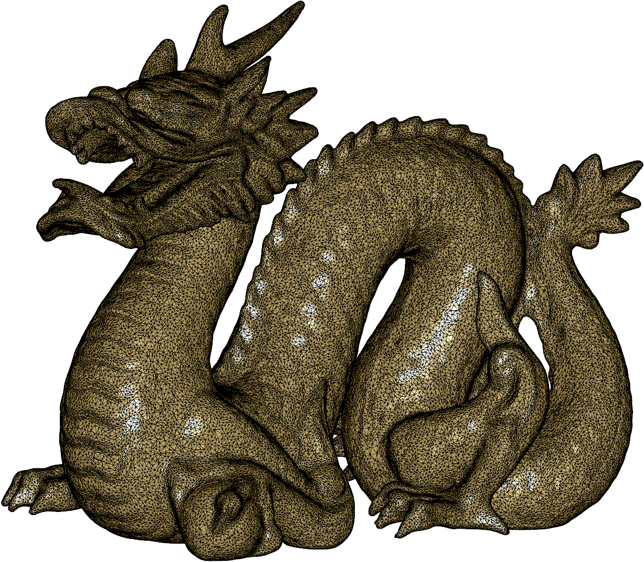
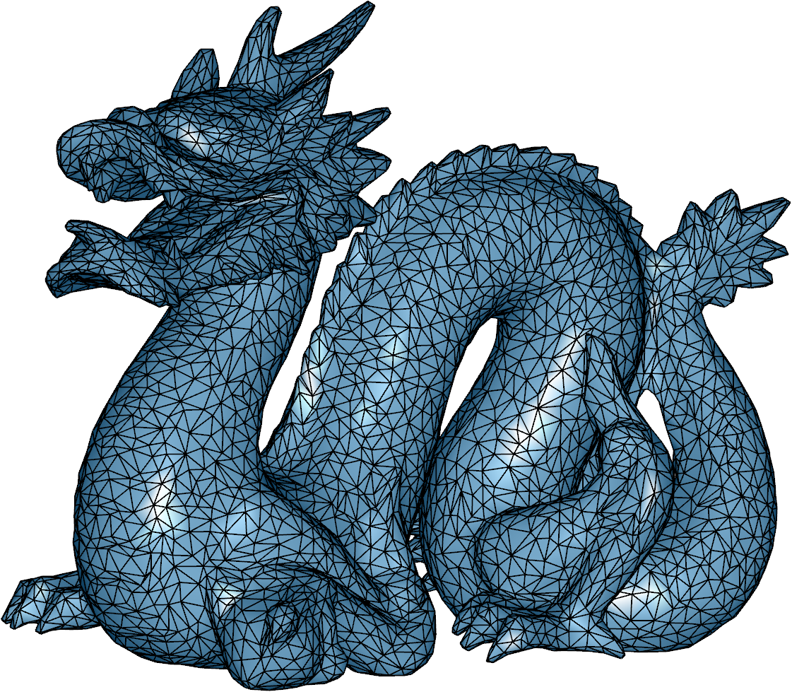
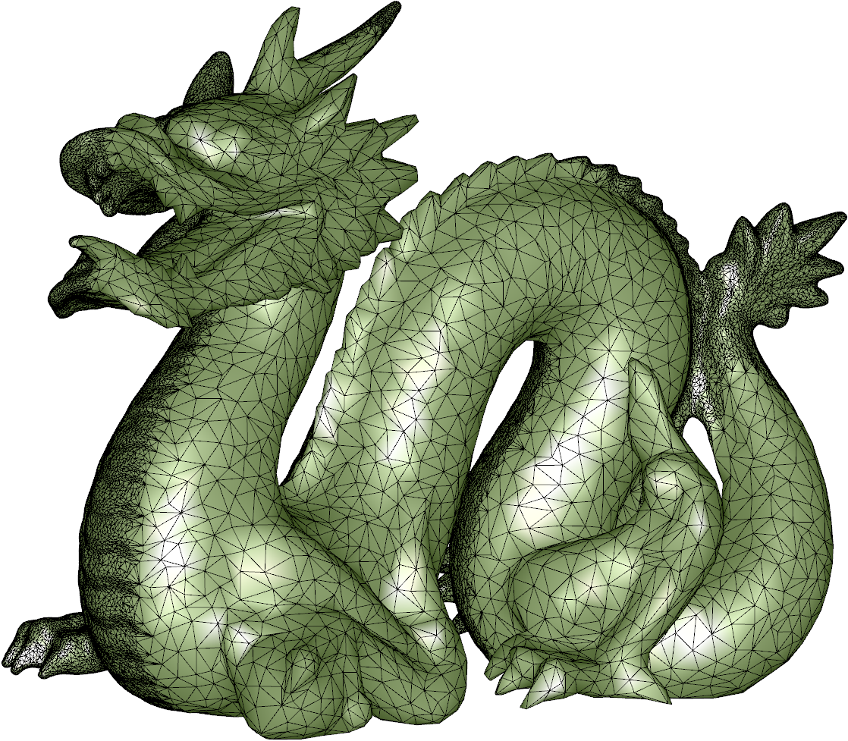
Why the (Laplacian) Operator Approach?
$$L∈ℝ^{n×n}$$
The Laplacian operator (i.e. matrix) encodes the surface up to isometry.
$n$: #vertices.
Original mesh
Coarse mesh
Unbalanced mesh
Invariance to shape representation
Triangle meshes
Quad meshes
Polygon meshes
Point clouds
Triangle soups
As the discretization of a continuous operator
n is the number of mesh vertices.

Slide 18



Our Goal: An Operator/Matrix Capturing Extrinsic Geometry
$$S∈ℝ^{n×n}$$
An operator-based approach to systematically introduce extrinsic geometry to many tasks
$$ℝ$$
def Intrinsic_Shape_Analysis( mesh)
L = Laplacian_Operator( mesh)
delete mesh
results = compute( L)
……
……
return results
We are looking for Some operator (i.e. matrix) $S$ encodes extrinsic geometry.
$n$: #vertices.
Extrinsic
Some-Extrinsic-Operator
Concurrent work [Liu et al. 2017] considers
alternative operators.
n is the number of mesh vertices.
Notes:
A natural question to ask is whether we can replicate the success of the Laplacian, find an
geometric operator that can play a similar role as the Laplacian but for extrinsic geometry.
Practically this means we are looking for an operator such that in existing algorithm, simple replacing the Laplacian using with this new operator hopefully will introduce extrinsic behaviors to the algorithm.
------------------
modify existing intrinsic algorithms by this one-line change, simple replacing the Laplacian with some extrinsic operator, to
Extrinsic algorithms for each specific task
hopefully encodes the surface up to rigid motion.
However, we haven’t seen an extrinsic geometry operator that can play a similar role as the Laplacian does for intrinsic tasks.
Instead, we take an operator-based approach to systematically introduce extrinsic geometry to many tasks.

Slide 19
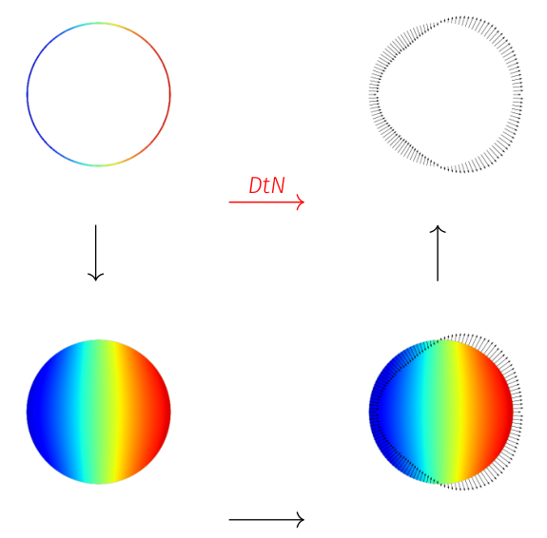

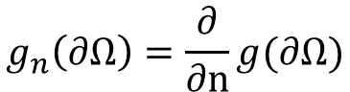
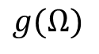
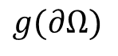
Dirichlet-to-Neumann (DtN) Operator $𝒮$
Consider a volume $Ω$ bounded by the surface $Γ=∂Ω$.
$$g(∂Ω)$$
$$g_{n}\left(∂Ω\right)=\frac{∂}{∂n}g(∂Ω)$$
$$g(Ω)$$
Notes:
Can we find such an operator? The answer is affirmative and
Here is the operator we consider.
For now let’s consider volumetric domain Omega bounded by a surface.
Now the surface is a simple sphere.
Consider the following process:
Given an arbitrary function g on the surface, whose value on the surface is encoded by color.
[1] we first smoothly interpolate the function into the interior, by computing the harmonic extension.
The harmonic extension is smooth,
[2] and we can compute its normal gradients at the boundary.
[3] This normal gradients g_n is another scalar function.
So we have an operator maps the given function to the resulting normal gradients.

Slide 20
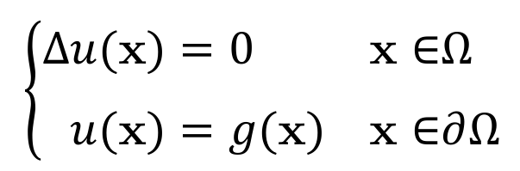
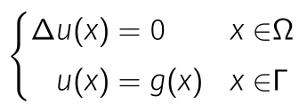

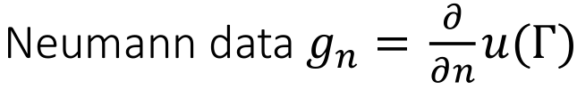

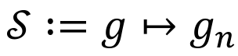
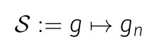
Dirichlet-to-Neumann (DtN) Operator $𝒮$
Consider a volume $Ω$ bounded by the surface $Γ=∂Ω$.
$$g(∂Ω)$$
$$g_{n}\left(∂Ω\right)=\frac{∂}{∂n}g(∂Ω)$$
Dirichlet-to-Neumann (DtN) operator:
Also known as the Steklov-Poincaré
operator.
$$g(Ω)$$
Notes:
Writing down the process in the mathematical language, we solve the Laplace equation with the Dirichlet data g.
[1] We are considering the operator that maps the Dirichlet data to the resulting Neumann data g_n.
For this reason this operator is called the DtN operator. It is also known as the Steklov-Poincaré operator so we use the symbol S to denote it.
One can further show that this operator is linear, which means one can discretize the operator by a matrix S.
[Physics interpretation of the geometry operator]
--------------------------------------
The normal derivative is called the Neumann data.
The given function on the surface

Slide 21
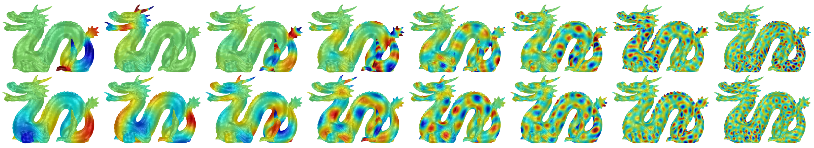
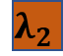


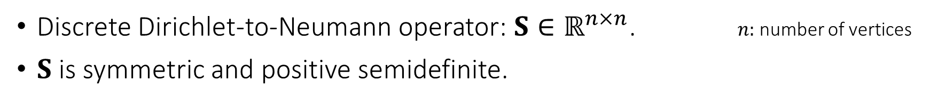
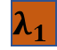



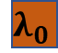

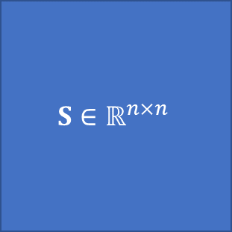




DtN operator and Steklov eigenvalue problem
Discrete Dirichlet-to-Neumann operator: $S∈ℝ^{n×n}$. $n:$ number of vertices
$S$ is symmetric and positive semidefinite.
$$S∈ℝ^{n×n}$$
$$φ_{0}$$
$$φ_{1}$$
$$φ_{2}$$
$$φ_{n}$$
$$λ_{0}$$
$$φ_{0}$$
$$φ_{1}$$
$$φ_{2}$$
$$φ_{n}$$
$$λ_{1}$$
$$=$$
$$λ_{2}$$
$$λ_{n}$$
This eigenvalue problem of $S$ is known as the Steklov eigenvalue problem.
Notes:
We even know the matrix will be positive semidefinite, so we can compute the
[1] eigen-decomposition of the DtN operator.
The eigendecomposition is known as the Steklov eigenvalue problem.
----------------------------------------------------------------------------------------------------------------------------
Here we show a few example of eigenfunctions computed on the dragon shape, that we later will have a close look.
Here we show a few example of eigenfunctions computed on the dragon shape, , corresponding to certain oscillation patterns with increasing frequencies.
Here we show a few eigenfunctions, corresponding to certain oscillation patterns with increasing frequencies.
The first few eigenfunctions correspond to the principal action of the operator on input signals.

Slide 22
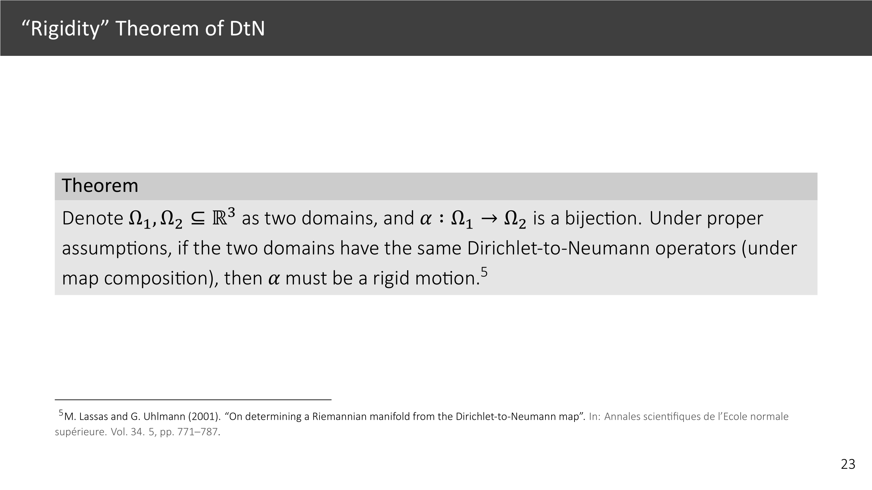
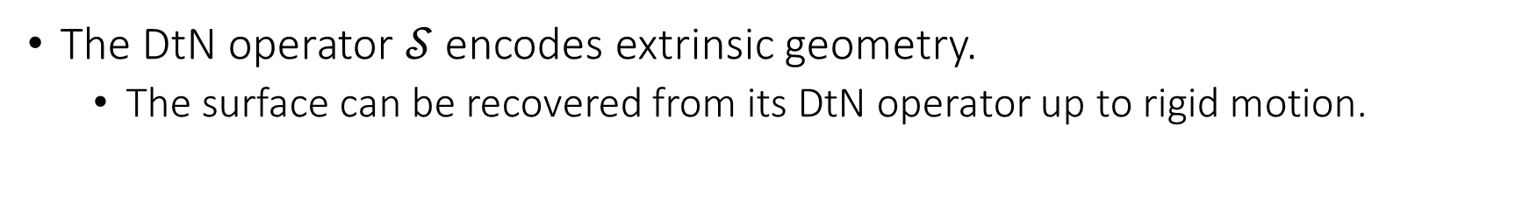
DtN Operator $𝒮$and Extrinsic Geometry
The DtN operator $𝒮$ encodes extrinsic geometry.
The surface can be recovered from its DtN operator up to rigid motion.
The DtN operator captures critical extrinsic quantities like the mean curvature.
Notes:
The DtN operator and its eigenvalue problem is closely related to extrinsic geometry.
[1] First, by some differential geometry argument, the surface can be recovered from its DtN operator up to rigid motion. Details can be found in the paepr. This fact means the DtN operator does not lose useful extrinsic information.

Slide 23
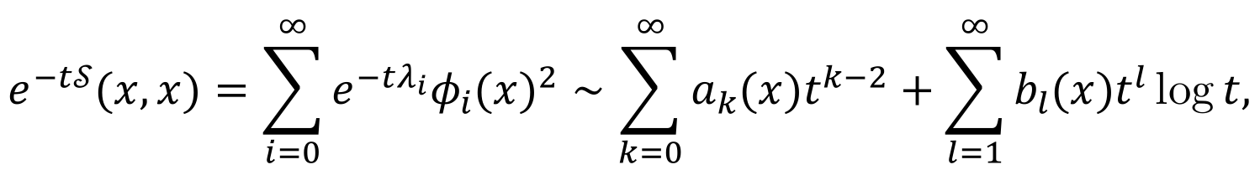
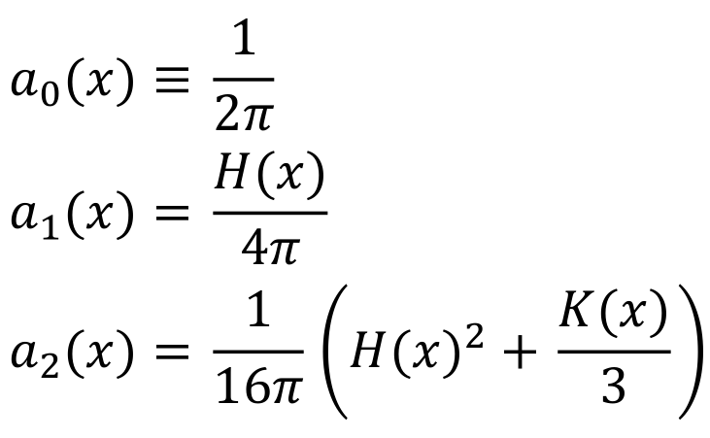
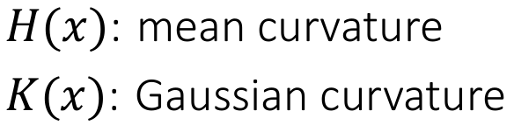
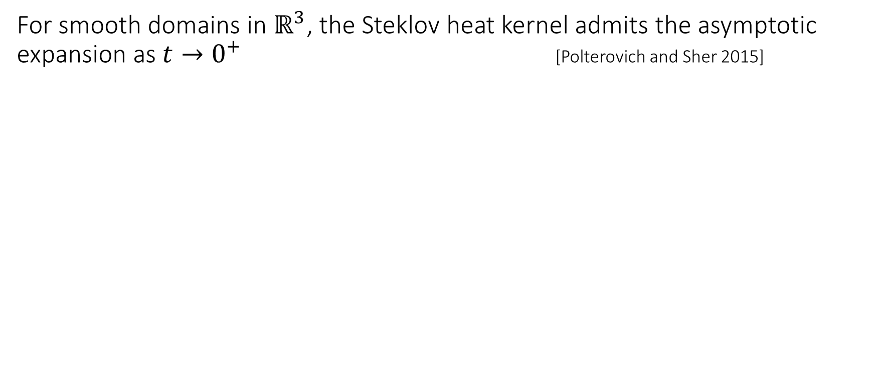
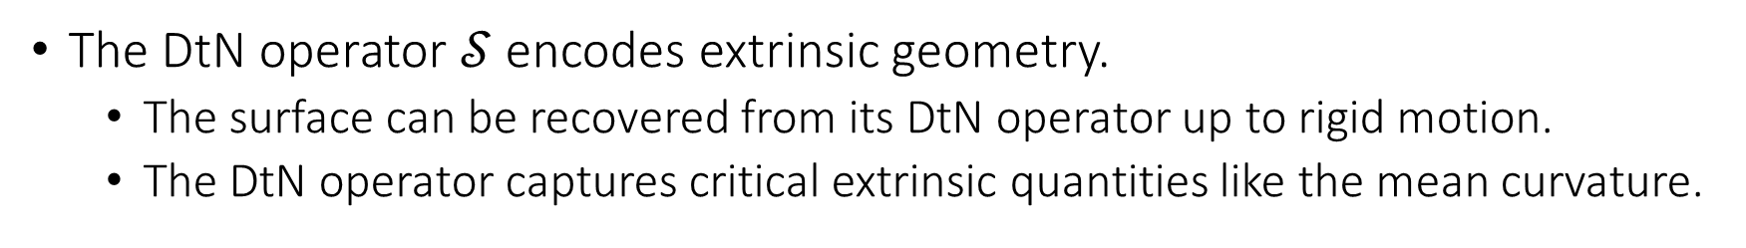
DtN Operator $𝒮$and Extrinsic Geometry
The DtN operator $𝒮$ encodes extrinsic geometry.
The surface can be recovered from its DtN operator up to rigid motion.
The DtN operator captures critical extrinsic quantities like the mean curvature.
For smooth domains in $ℝ^{3}$, the Steklov heat kernel admits the asymptotic expansion as $t→0^{+}$ [Polterovich and Sher 2015]
Notes:
Second The DtN operator captures critical extrinsic quantities like the mean curvature.
[1] Particularly, the following results was established that, the Steklov heat kernel, defined using eigenfunctions, admits an asymptotic expansion closely related to the extrinsic mean curvature.
This has practical implications,
----------------------------------------------------------
extrinsic mean curvature plays a prominent role.
the connection
The DtN operator encodes volumetric geometry.

Slide 24
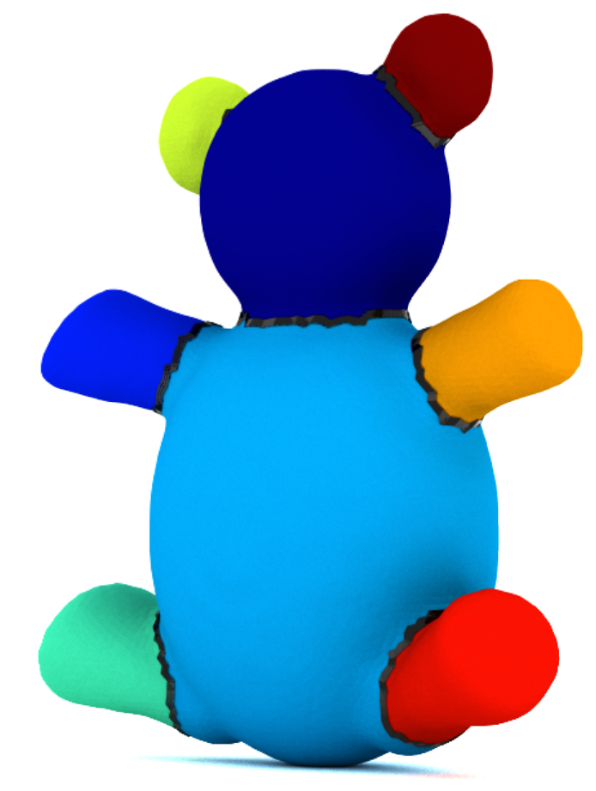
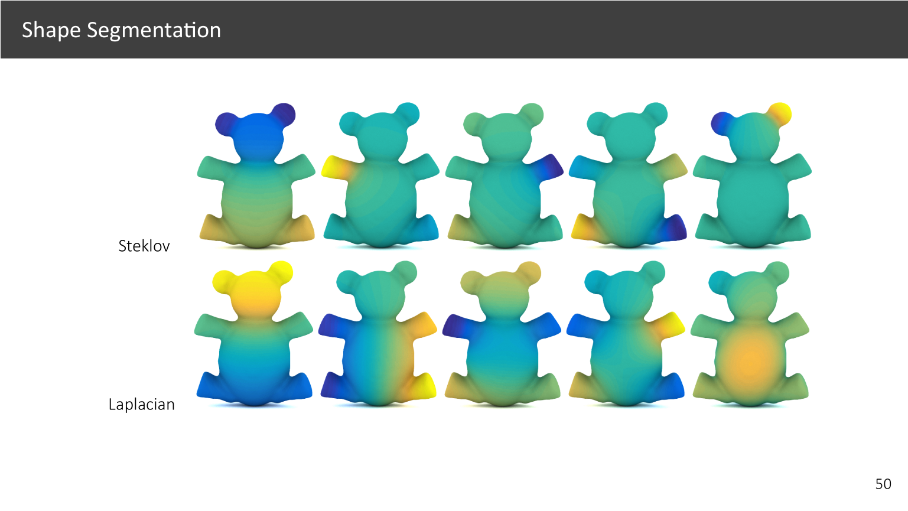
Steklov Eigenfunctions and Extrinsic Geometry
Level sets of Steklov eigenfunctions conform to mean curvatures.
Notes:
Indeed the behavior of our operator is strongly influenced by the extrinsic mean curvature function.
Here we illustrate the first few Steklov eigenfunctions.
[1] We can see the level sets of Steklov eigenfunctions conform with seams along which the mean curvature has a large value, as being pointed out.
[2] Indeed simply applying this eigenfunctions leads to a reasonable segmentation and separates the teddy bear into few volumetric parts.

Slide 25
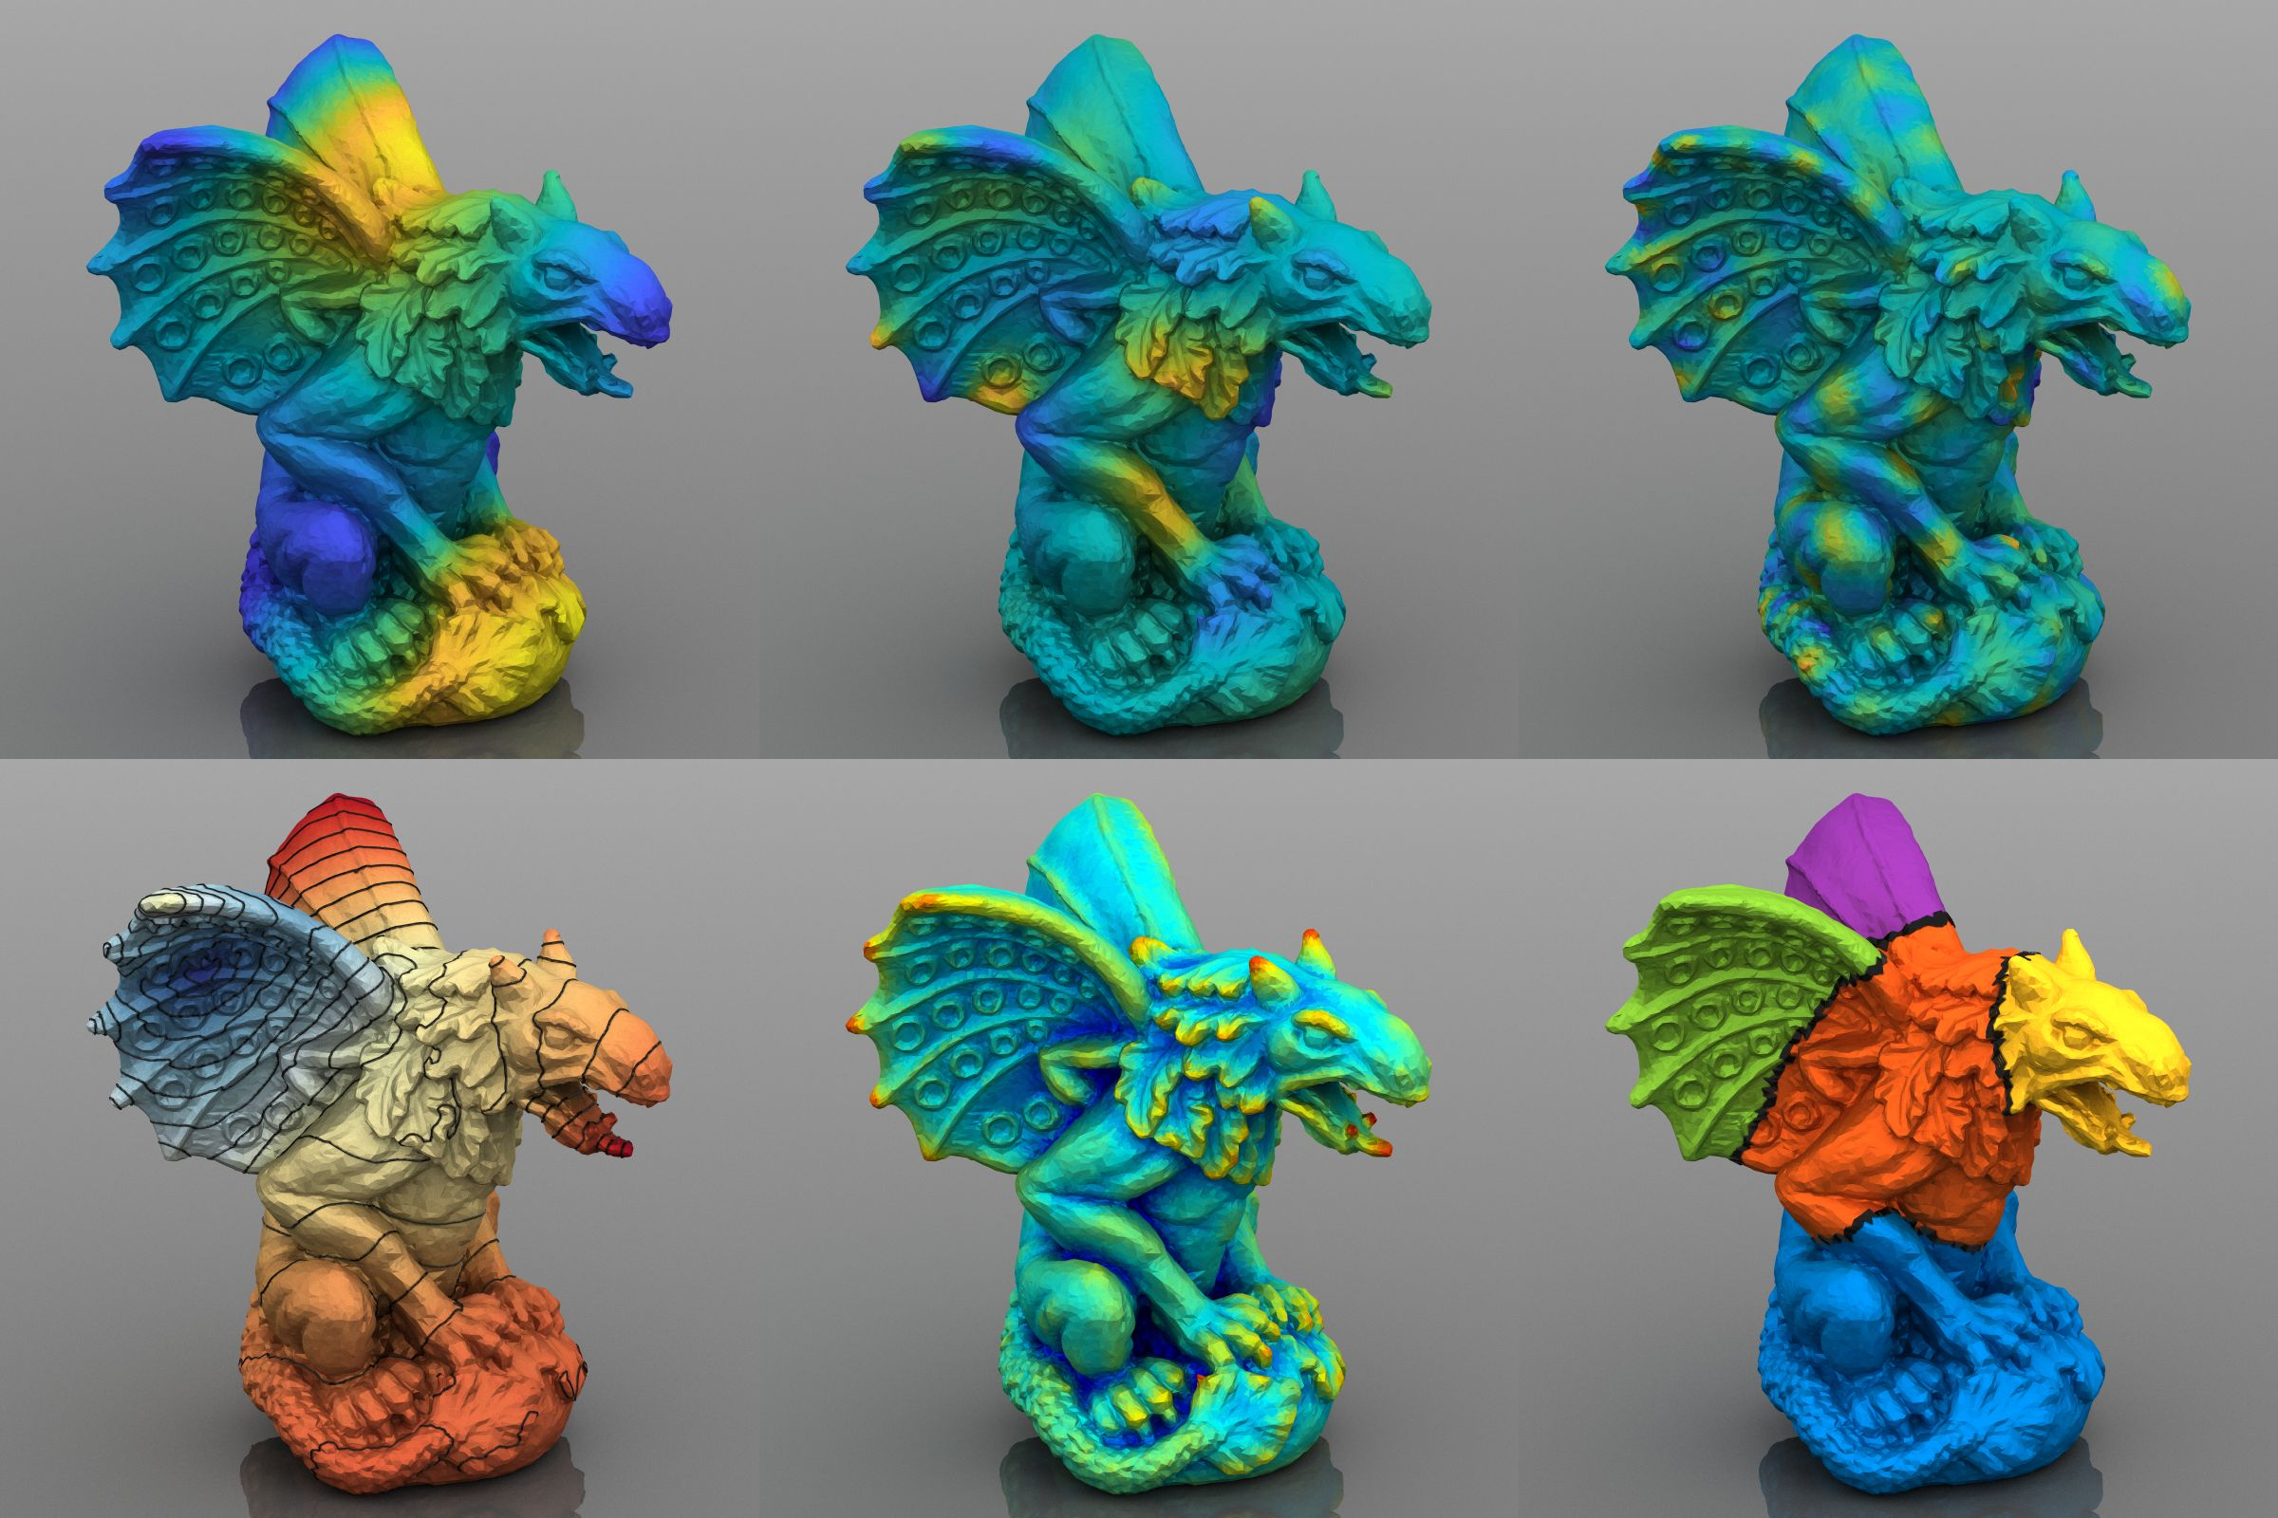
Quantities Defined using
Eigenfunctions
Notes:
Further, eigenfunctions can be used to define and derive many quantities,
Which provides not only applications, but also means to validate and test the behaviors of our operator.

Slide 26
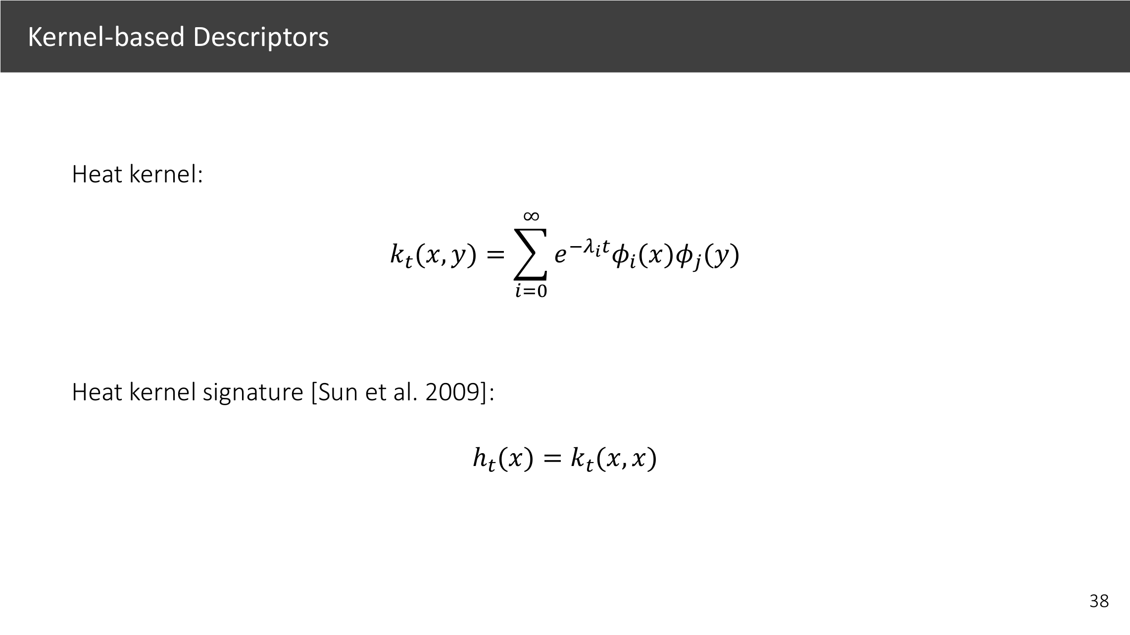
Steklov
Laplacian eigenfunctions/eigenvalues
Notes:
The popular heat kernel signature is originally introduced using a simple formula using Laplacian eigenfunctions.
[1] Simple replacing them with the Steklov ones will lead to signature aware of extrinsic geometry.

Slide 27
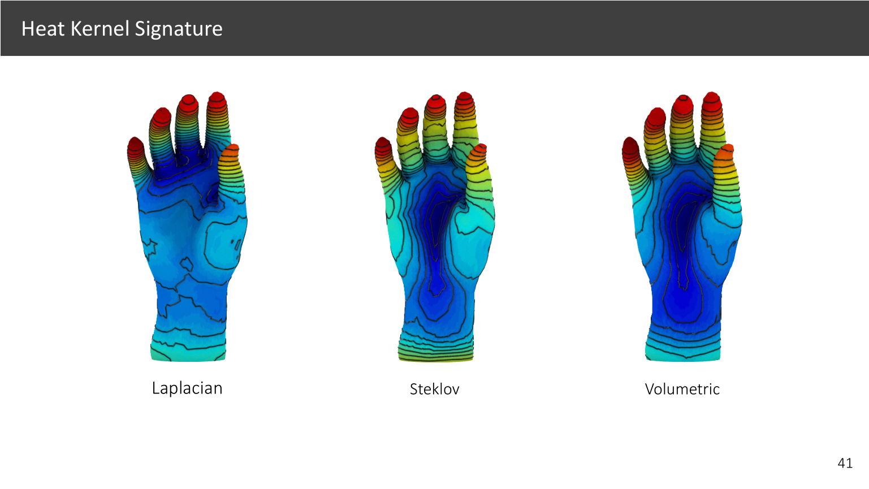
Steklov heat kernel signature as a “multi-scale mean curvature”
Notes:
Here we have the Laplacian and Steklov heat kernel signatures computed on the hand.
[1] At the center of the hand there is large mean curvature, this is reflected in the Steklov signature.
[2] The Laplacian signature, however, is insensitive to it.
[3] On this model of gargoyle, the Steklov signature looks like the mean curvature but in a multi-scale sense.

Slide 28
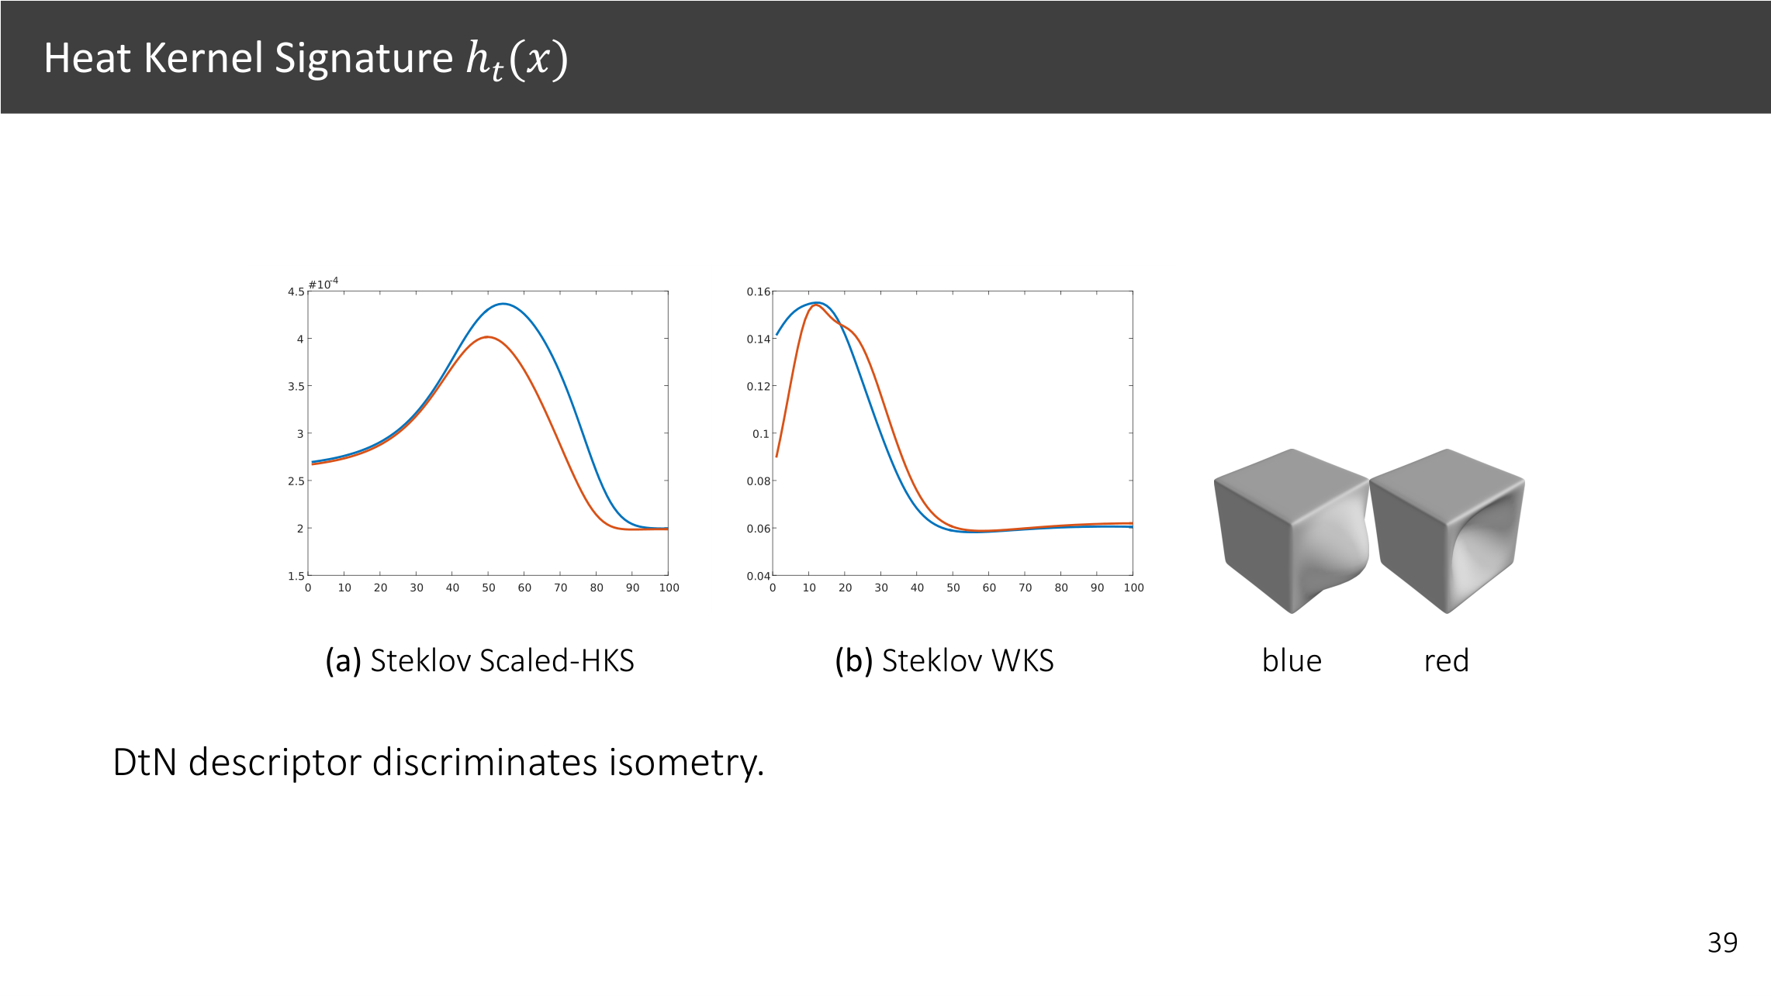


Notes:
Again, for these two cubes, we see the Steklov one gives distinct signatures, well the Laplacian one gives exactly same signature, failing to distinguish them.

Slide 29

Notes:
Let’s have another look of the Steklov and Laplacian eigenfunctions on the dragon model.
Here is the 10th eigenfunctions.

Slide 30

Notes:
We can move to larger eigenvalues and we see denser and denser oscillation patterns for both eigenfunctions.

Slide 31

Notes:
We can move to larger eigenvalues and we see denser and denser oscillation patterns for both eigenfunctions.

Slide 32

Notes:
We can move to larger eigenvalues and we see denser and denser oscillation patterns for both eigenfunctions.

Slide 33

Notes:
We can move to larger eigenvalues and we see denser and denser oscillation patterns for both eigenfunctions.

Slide 34

Notes:
But there is a clear difference in the pattern of eigenfunctions.
[1] The body of the dragon roughly looks like a cylinder.
The Steklov eigenfunction varies along the edge of this cylinder.
This is the volume behavior for cylinder-like shape, due separation of variables for symmetric shapes.
[2] It is very different from that of the Laplacian, in which you see the level sets are geodesic disks on the surface.
---------------------------------------------------------------
The Steklov eigenfunction has the nodal set, the eigenfunction level-set, varies along the body of the dragon.

Slide 35

Steklov
Laplacian eigenfunctions/eigenvalues
Notes:
We can further verify the volumetric behavior by computing the spectral distance from Steklov eigenfuntions.
-----------------------------------------------------------------------------------------------------
, which provides even better means to visualize and understand the Steklov eigenfunctions.
which are Euclidean distance in the

Slide 36


Back
Front
Pancake-like shape
Notes:
Here we have a pancake-like shape, on which we compute the distance field to the center of the front side,
[1] as pointed out.
If we look at the center from the other side,
[2] we see the Laplacian distance considers the back side very from the front center,
[3] different from the other two.
This is because the Steklov and Volumetric distances are allowed to travel through the interior of the surface while the Laplacian one has to traverse along geodesic on the surface.
------------------------

Slide 37

Back
Why not simply using (inverse) Euclidean distance between points as the metric?
We would like two hands to be far apart from each other!
Front
Notes:
Here we are seeing that using all methods, the two hands of the Micky mouse are far apart from each other.
[1]
A natural question to ask is why not simply using (inverse) Euclidean distance between points as the metric? The reason is best illustrated in this example.

Slide 38

Back
Front
Notes:
Here we have a different bunny model. Again the Steklov distance looks very similar to the volumetric one, but remember our computation is purely on the surface without any interior volumetric discretization, as we will discuss next.

Slide 39

Dirichlet-to-Neumann (DtN) Operator $𝒮$
Consider a volume $Ω$ bounded by the surface $Γ=∂Ω$
$$g(∂Ω)$$
$$g_{n}\left(∂Ω\right)=\frac{∂}{∂n}g(∂Ω)$$
Dirichlet-to-Neumann (DtN) operator:
Also known as the Steklov-Poincaré
operator.
$$g(Ω)$$
Notes:
OK, how do we discretize the DtN operator?
Recall in this previous slides we have defined
[1] the DtN operator as this map in a rather indirect way, but we do not know how to compute it yet.

Slide 40

Notes:
Using the theory of partial differential equation, we can show that the DtN operator can be written as the composition of a few boundary operators V,K,T, and H.
boundary integral operators that are straightforward to discretize and can be defined even for open surfaces.
As we will see now,

Slide 41

Notes:
Take the single layer potential operator V for example, the operator is defined as boundary integral involving the Laplace kernel G, the inverse distance between two points x and y.
The operator V after discretization is nothing but a matrix which stores the piece wise inverse distance between vertices.

Slide 42
Notes:
K,T,H are similar boundary integral operatots but

Slide 43

Notes:
Here we provide the formulas that will be used to assemble all these operators.
They are kernel matrix involving the inverse distance, and relative normal directions.
These matrices can be straightforwardly assembled using boundary element method.

Slide 44


Slide 45

Boundary Element Method (BEM) with Fast Computations
Hierarchical matrix (H-matrix): reduces complexity to 𝒪(𝑛 log1/𝜖 ).
Iterative eigensolver for top k eigenfunctions.
Provably optimal preconditioners are available.
Notes:
All these operators are dense matrices, and we apply the hierarchal matrix method to reduce the cost to linear complexity.
And we further use a preconditioned iterative eigensolver to speedup the computation, details can be found in the paper.

Slide 46


Steklov Eigenvalues as the “ShapeDNA” (i.e. Shape2Vec)

Slide 47


Slide 48

Convergence and Robustness to Irregular Meshing
Low 14k
Medium 54k
High 220k
Unbalanced 7k+110k

Slide 49

Robustness

Slide 50

Robustness

Slide 51


Slide 52


Slide 53


Slide 54


Slide 55




Our BEM Formulation v.s. A Possible FEM Operator

Slide 56

Notes:
Concurrent work [Liu et al. 2017] considers
alternative operators.

Slide 57



Slide 58


Slide 59


Slide 60

Conclusion
Surface-only approach using the boundary element method.
An operator approach for extrinsic geometry for many applications.
Code available
Notes:
Surface-only approach using the boundary element method.
An operator approach for extrinsic geometry for many applications.

Slide 61
Future Work
Integral geometry operators.
Justify the use of DtN operator in various applications:
Shape deformation, physical simulation, skinning animation, interpolation weights, volumetric parameterization, meshing, vector and frame field design, statistical learning on manifolds, and geometric deep learning.
A mathematical theory for open surfaces and point clouds.
Open question: “Can you hear the shape of a drum (from Steklov eigenvalues)?”
Code available
Notes:
Integral geometry operators have not been used much in shape analysis and we would like to explore a large family of geometric operators.
Besides what we show in the paper, there are a variety of applications that potentially will benefit from our operators.
It would be interesting to justify the usage of DtN operator in a large number of applications, as well as its usage for open surfaces and point clouds.
Inverse problems such as can you recover the shape from Steklov eigenvalues is also an interesting question.
-------------------------------------------------------------------------
There are a variety of applications that potentially will benefit from our operators.
Replicated the remarkable success of the Laplacian operator.
currently our methods takes a few minutes
Speedup the BEM computation

Slide 62
Thank you! Q&A

Slide 63


Slide 64


Slide 65


Slide 66


Slide 67

The surface can be recovered from its DtN operator up to rigid motion.

Slide 68


Slide 69


Slide 71


Slide 72
Why Not Volumetric Laplacian?
We aim at working with surfaces itself.
Tetrahedralizing meshes itself is a challenging task, as many datasets in graphics contain noisy, non-watertight, and non-closed surface meshes.
We would like to measure differences and distortions between two surfaces, so we would need to attribute the interior differences and distortions to the surface.
Faithfully computing volumetric eigenvalues requires a dense volume mesh with a DoF much larger than that of the surface mesh.
Otherwise the results will be dependent on the (coarse) tetrahedralization.

Slide 74


Slide 75


